Slide 1



Surveys to Strategy
A Multi-Agent Approach
towards Autonomous Decision Making
Group 3
4 February 2026

Slide 2






The Team - UCLA MSBA’26
Yubin Hu
Jinwoo Roh
Emmet Andrews
Sam (Xiangyi) Kong
Anna (Gexuan) Zhu
Pranav Piedy

Slide 3
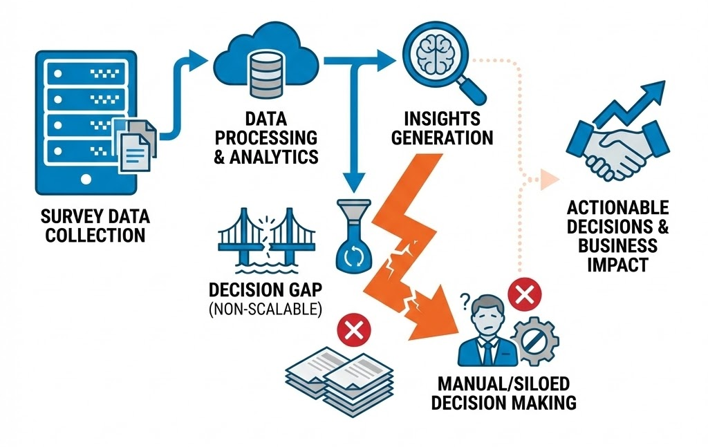
Lack of a Scalable Decision System
We have the data, we have the insights. Now what?
Voice of Customer Division at Dell gets tons of surveys back
Old model: generates keywords of potential problems
Questions: Where exactly is the problem? Why? And what do I fix first? How do I fix it?

Slide 4
NLP vs Multi Agent Framework
Agents act as digital employees. They autonomously log into ServiceNow, categorize the ticket, and draft a response, closing the loop instantly.
Active Resolution vs. Passive Reporting
NLP is trapped inside the text box. Agents have hands. They can query your Inventory System, check Order Status, and ping Engineering Slack channels to verify facts before reporting back.
NLP - "Screen Flicker: 500 mentions". Agents diagnose the problem by correlating those mentions with other data sources, telling you: "Screen flicker is only happening on XPS 13 units running the v1.2 driver."
Dynamic Tool Use vs. Static Text
Deep Reasoning vs. Keyword Matching

Slide 5
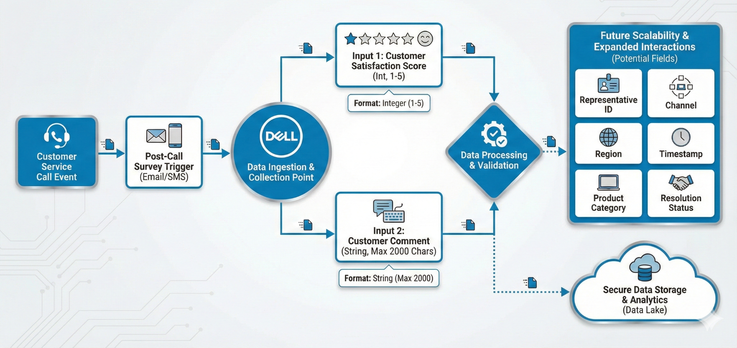
Survey Inputs

Slide 6
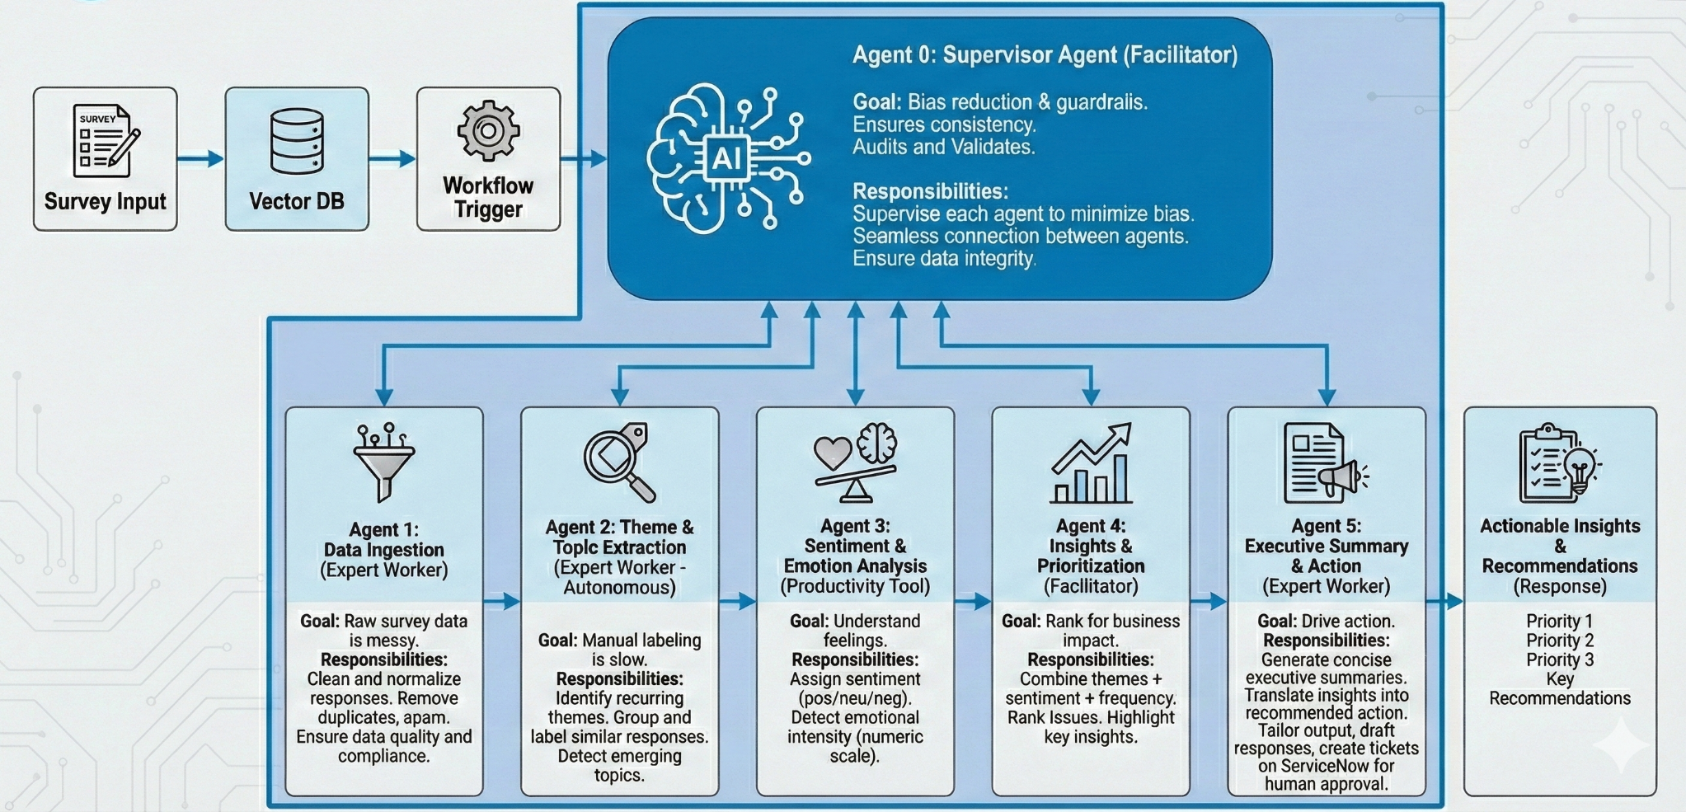
Agentic System Design

Slide 7
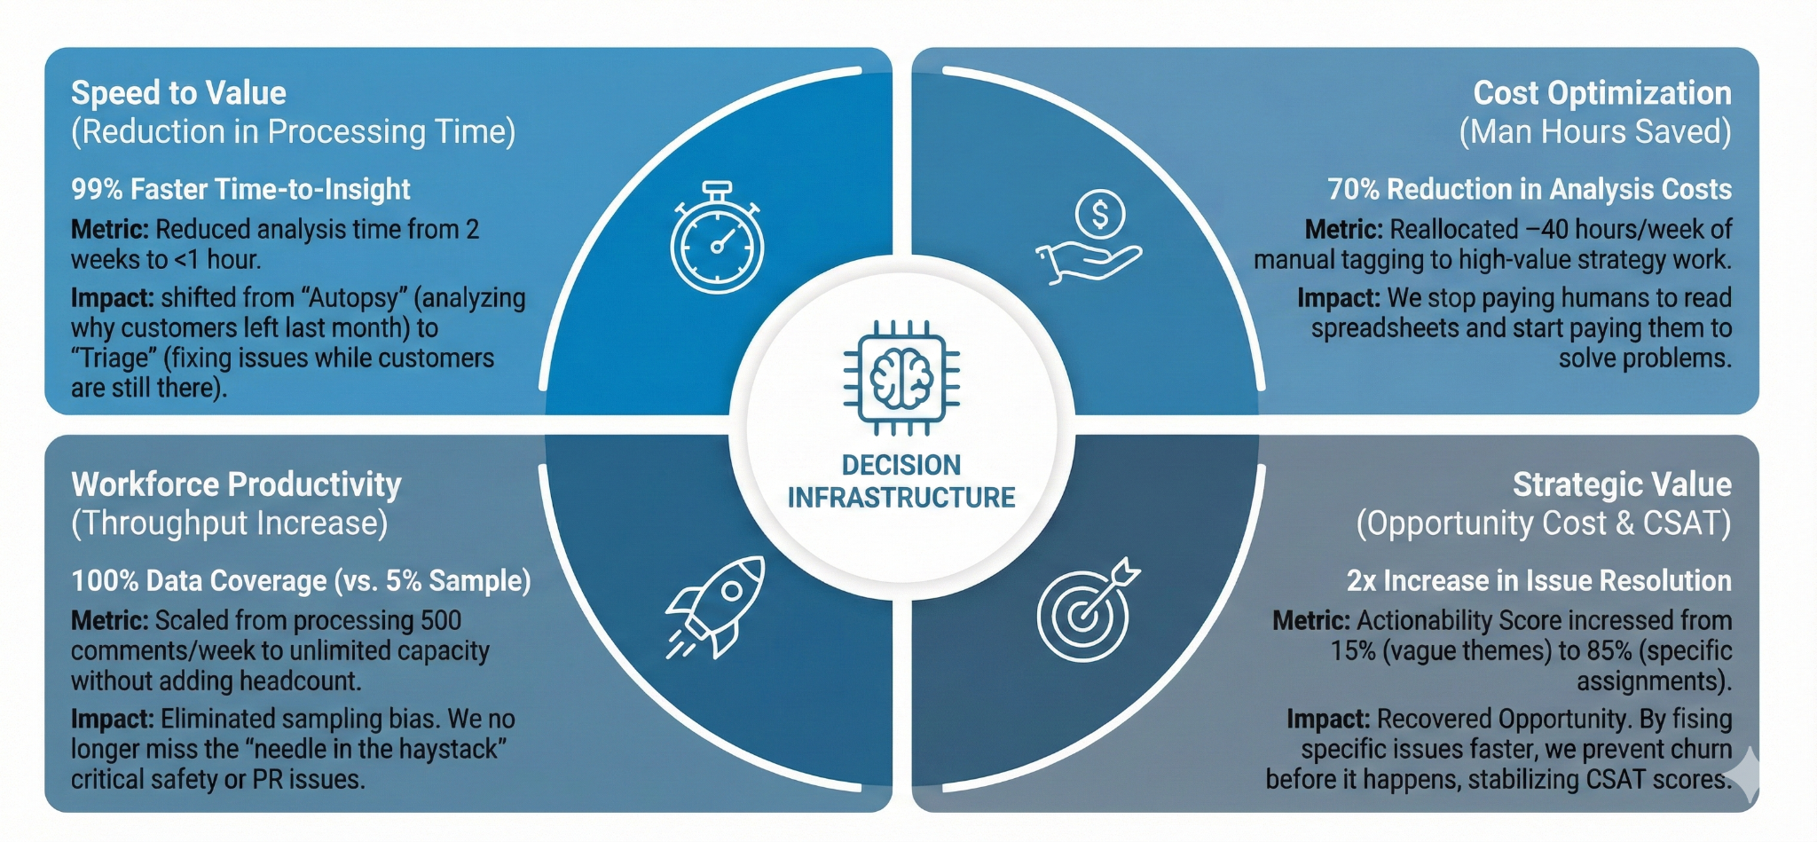
So what? Business Impact

Slide 8
Thank you

